Slide 1
Car Sale Insights
Project
(SQL
&
Tableau)

Slide 2
Key Objective:
The project aims to provide valuable information and answers to key questions related to customer distribution across states, customer preferences for vehicle makers, customer satisfaction trends, revenue trends, and other important metrics.
The key objective of the project is to leverage data analytics techniques to gain actionable insights that can support business decision-making, optimize sales strategies, improve customer satisfaction, and drive revenue growth in the car sales industry.

Slide 3
Data Description:
Data set consist 1000 rows and has 4 different CSV file of the following:
Customer Data -
Orders Data -
customer_id
customer_name
Gender
job_title
phone_number
email_address
city, country
State
customer_address
postal_code
credit_card_type
credit_card_number
order_id
customer_id
shipper_id
product_id
Quantity
car_price
order_date
ship_date
Discount
ship_mode
Shipping
customer_feedback
quarter_number

Slide 4
Product Data -
product_id
vehicle_maker
vehicle_model
vehicle_color
car_model_year
car_price
Shippers Details -
shipper_id
shipper_name
shipper_contact_details

Slide 5
ER Diagram:
Orders_data
order_id
customer_id
shipper_id
product_id
Quantity
car_price
order_date
ship_date
Discount
ship_mode
Shipping
customer_feedback
quarter_number
Product_data
product_id
vehicle_maker
vehicle_model
vehicle_color
car_model_year
car_price
Customer_data
customer_id
customer_name
Gender
job_title
phone_number
email_address
city, country
State
customer_address
postal_code
credit_card_type
credit_card_number
Shipper_details
shipper_id
shipper_name
shipper_contact_details

Slide 6

Solving Problem statement with SQL quires:
1. Total Sales
“Total sales generated in year is $48.61 Million”
"To retrieve the total Sales by multiplying the car price with the quantity and discount, and then rounding the result"

Slide 7


2. Total number of order Received
“Total number of order received in year is 1512”
"To retrieve the total number of orders by summing the quantity."

Slide 8
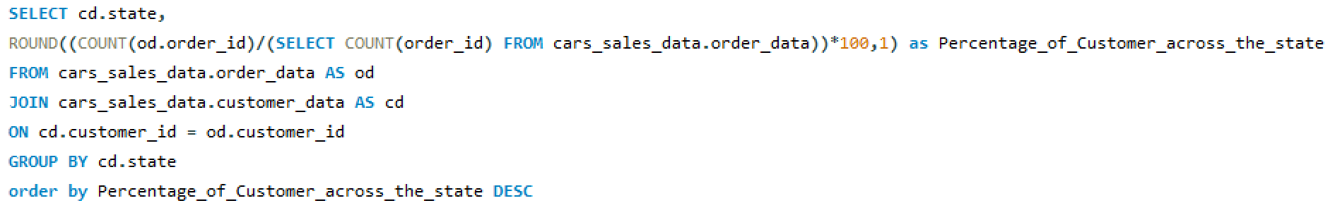
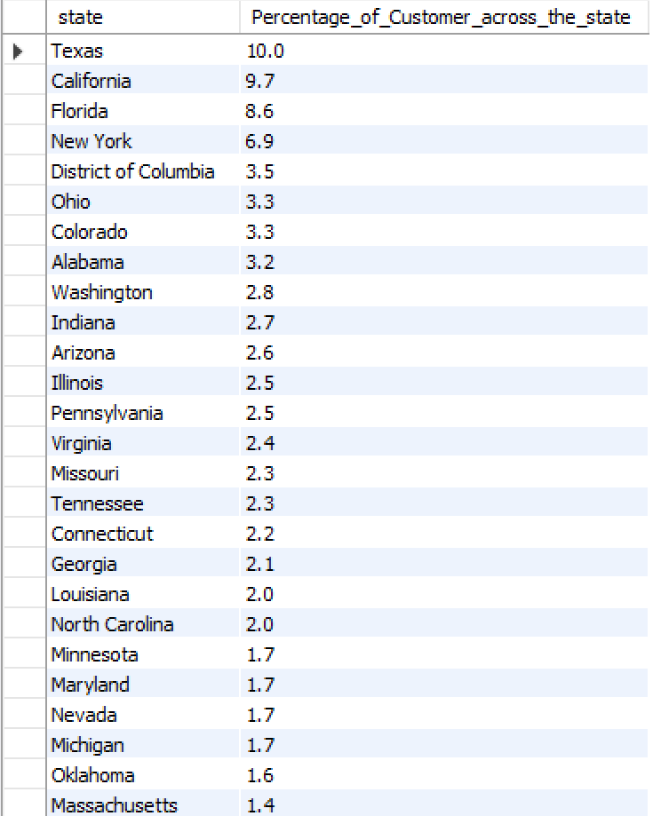
3. Distribution percentage of customers across states
“To retrieve the state and the percentage of customers across each state, rounded to one decimal place, based on the count of orders compared to the total number of orders.
The results are grouped by state and sorted in descending order”

Slide 9
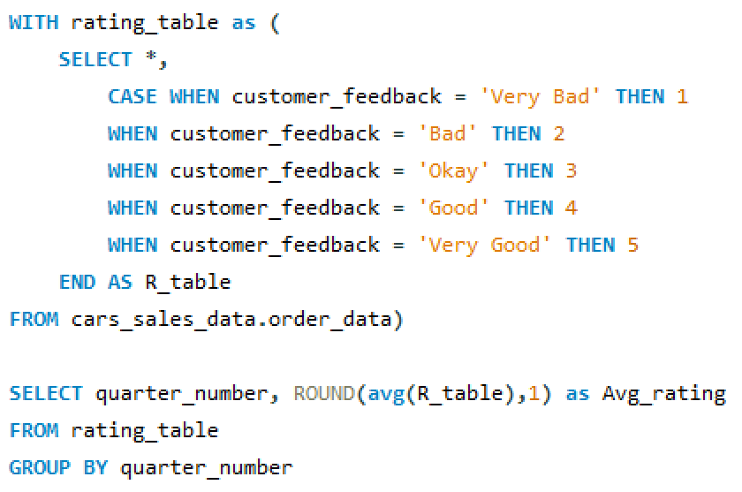
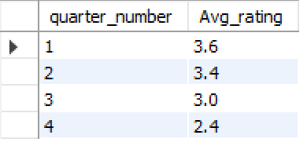
4. Average rating in each quarter
“A decreasing rating by quarter could indicate a decline in customer satisfaction, potentially leading to lower customer retention and loyalty”
"By utilizing a Common Table Expression (CTE) called 'rating_table' with a rating scale for customer feedback, the average rating per quarter is calculated from the order data and rounded to one decimal place."

Slide 10
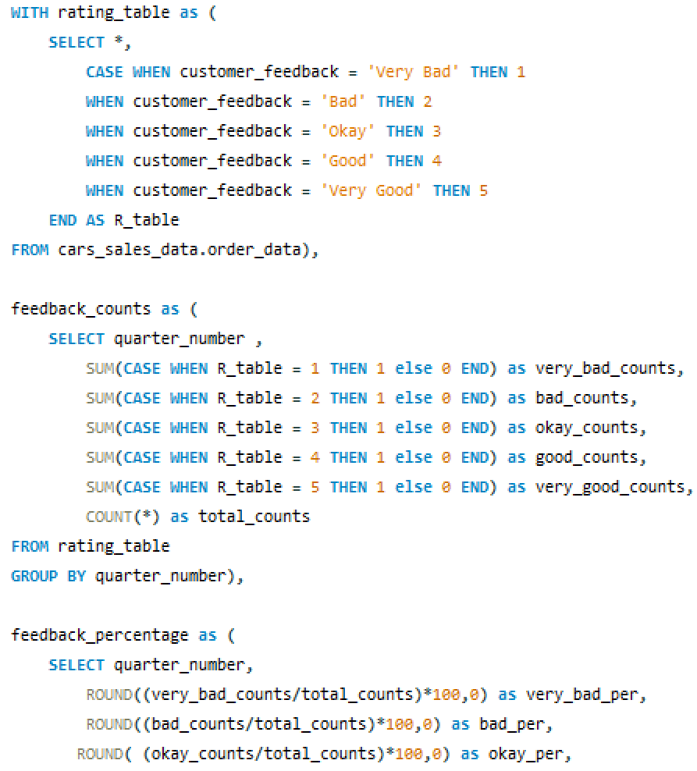
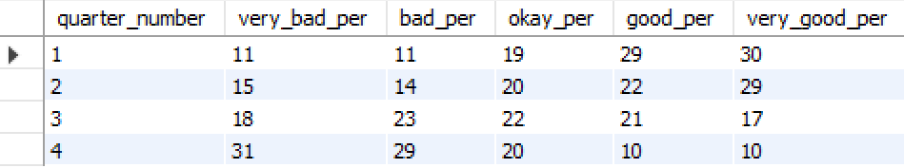
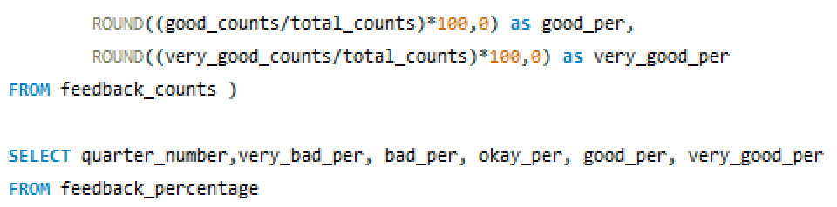
5. Identifying the customers getting more dissatisfied over time.
"In Q1, there were a good number of ratings in the 'very good' category and fewer in the 'very bad' category. However, over time, in Q4, the situation is almost reversed.”
“The query calculates the percentage of different customer feedback categories (Very Bad, Bad, Okay, Good, Very Good) for each quarter based on the provided ratings, allowing for an analysis of customer sentiment trends over time.”
“By using the feedback_percentage CTE, the query provides insights into the distribution of customer feedback categories (Very Bad, Bad, Okay, Good, Very Good) across different quarters, enabling the identification of any significant changes or patterns in customer sentiment.”

Slide 11
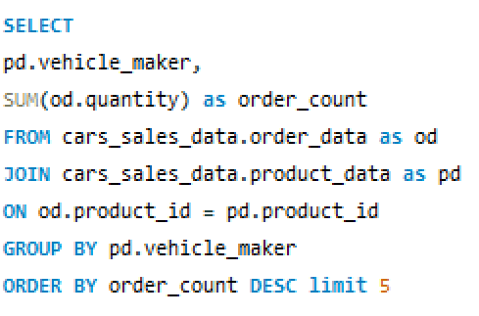
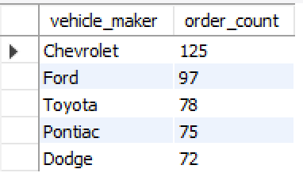
6. Top 5 vehicle makers preferred by the customer
"Chevrolet is the highest-selling car in the USA, followed by Ford, Toyota, Pontiac, and Dodge."
"To retrieve the top 5 vehicle makers, sum the quantity of orders by customer. The results should be grouped by vehicle maker and ordered by order quantity."

Slide 12
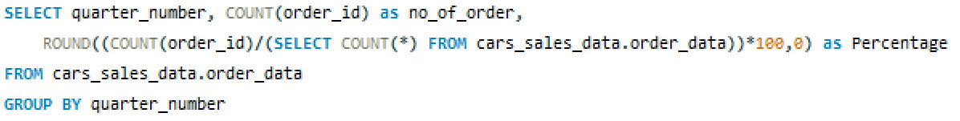
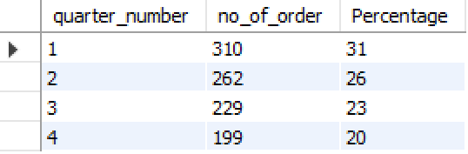
7. Trend of number of orders by quarters?
"In Q1, the maximum number of orders was received, but in Q4, it decreased by 11% compared to Q1."
“To retrieve the quarter number, the count of orders in each quarter and the percentage of orders in each quarter and results are grouped by the quarter number."

Slide 13
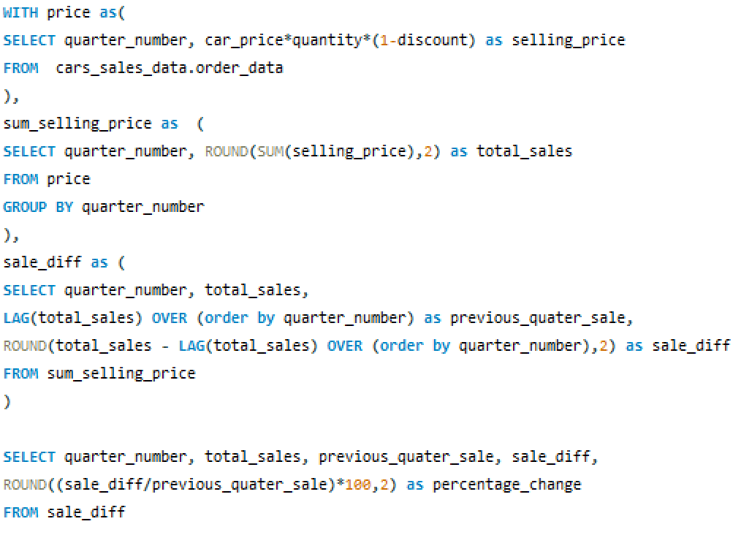
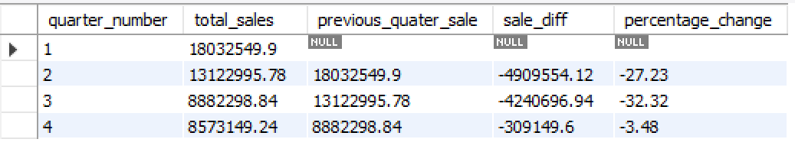
8. Quarter over quarter % change in revenue?
"The revenue percentage has declined each quarter, and in Q3, sales experienced the highest decline at 32.32%."
“This query calculates the total sales, previous quarter's sales, sales difference, and percentage change for each quarter, based on the sales data from the cars sales data table. It utilizes Common Table Expressions (CTEs) and window functions to perform the necessary calculations"

Slide 14
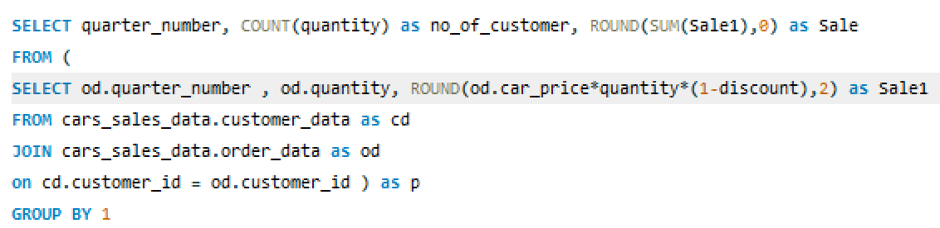
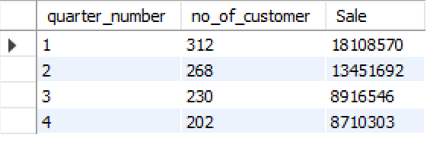
9. Trend of revenue and orders by quarters
"Q1 recorded the highest number of orders and sales, which decreased in the last quarter of the year."
"To retrieve the number of customers and total sales for each quarter, we join the customer and order data tables and use the SUM or COUNT function. The results are grouped by quarter number, providing insights into customer count and rounded sales figures."

Slide 15
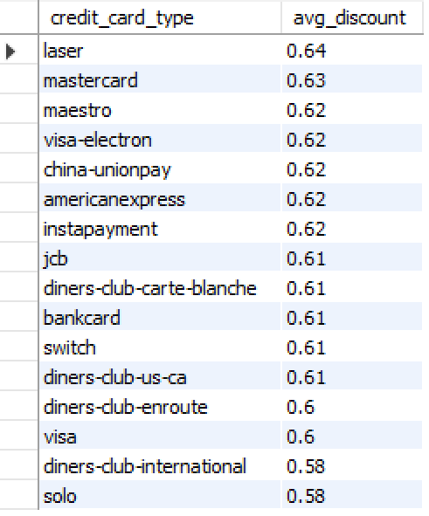
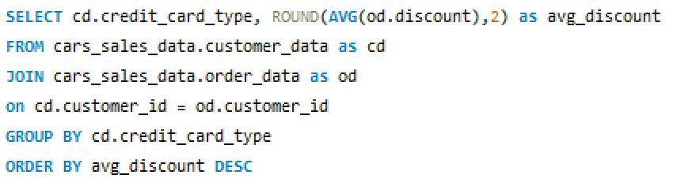
10. Average discount offered for different types of credit cards.
“Average discount issued by the different vehicle maker is almost the same to different credit card holders”
“To retrieves the average discount for each credit card type by joins the tables based on the customer id and then grouped by credit card type and sorted in descending order"

Slide 16
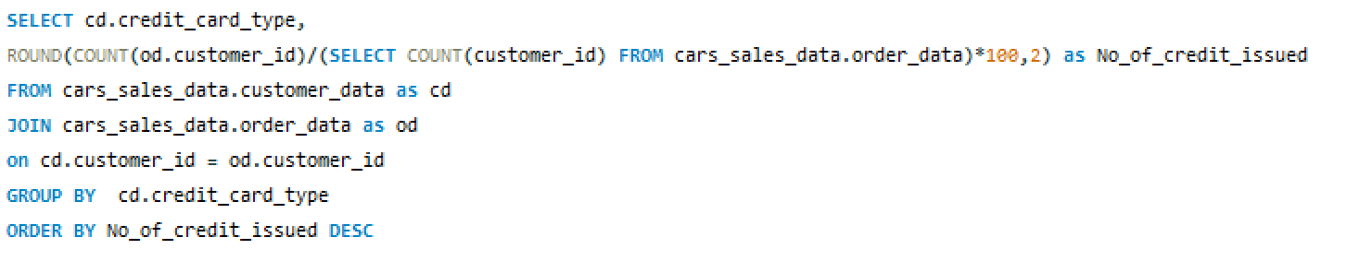
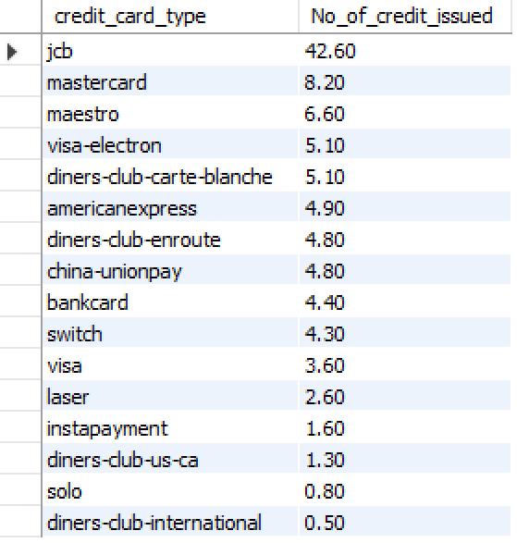
11. Percentage of Credit Card used to purchase car
"The most commonly used credit card for purchasing vehicles is 'JCB,' accounting for 42.60% of all transactions."
"To calculate the number of credit cards used for purchases based on the count of orders made by customers and then group the results by credit card."

Slide 17
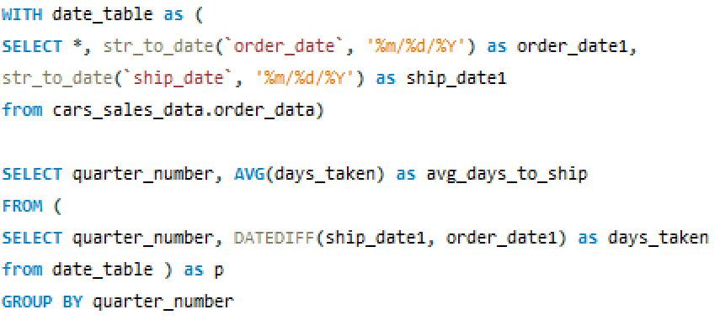
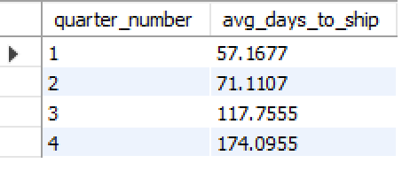
12. Average time taken to ship the placed orders for each quarters
"The average shipping time to deliver the car to the customer increased from 57 days in Q1 to 174 days in Q4."
"To calculate the average shipping days, first convert the order and ship dates into date objects. Then, calculate the difference between the two dates. Finally, group the results by quarter."

Slide 18
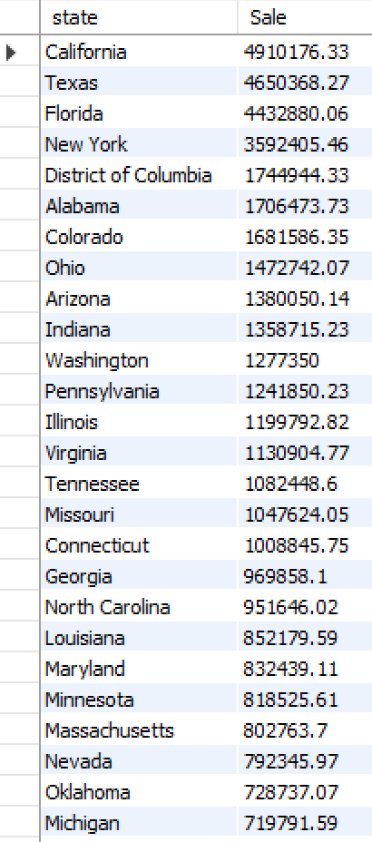
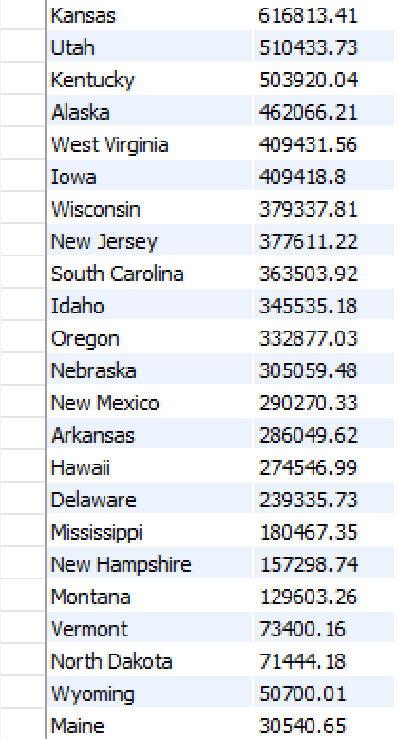
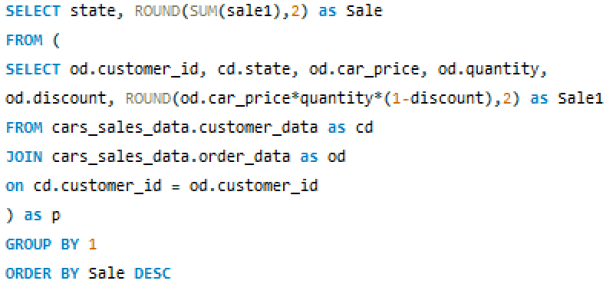
13. State wise Cars Sale
“California is on the top in terms of car sales among other state which is $4.9 Million”
"To retrieve the total sales for each state, the statement joins the customer and order data tables. It calculates the sales by multiplying the car price, quantity, and discount, rounding the result to two decimal places. The results are then grouped by state and sorted in descending order based on sales."

Slide 19
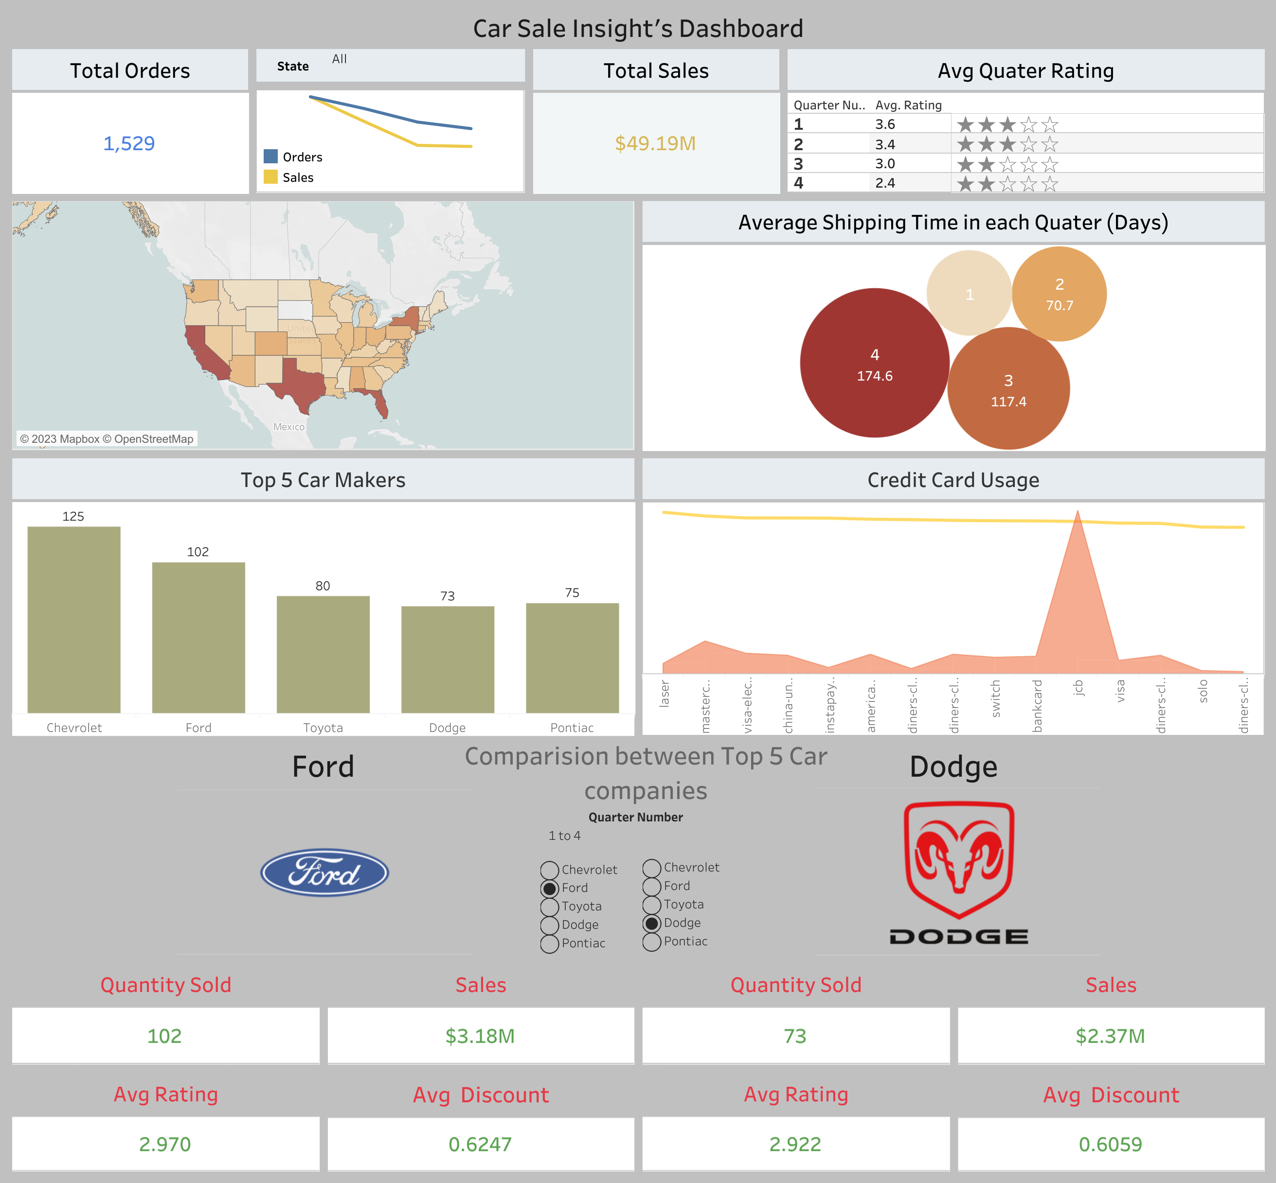
Car Sale Insight’s Dashboard
using Tableau

Slide 20
Observation and Recommendation:
Customer rating and Average shipping days can be the major factor for decline in sales in each quarter.
Customer ratings and average shipping days can be major factors contributing to the decline in sales each quarter. In the 1st Quarter, the percentage of 'Very Good' ratings was 30%, gradually decreasing to 29% in the 2nd Quarter, 17% in the 3rd Quarter, and 10% in the 4th Quarter. Conversely, the percentage of 'Very Bad' ratings increased from 11% in the 1st Quarter to 31% in the 4th Quarter.
Recommendation/ Solution
Companies should prioritize customer service experience and after-sales services by providing timely service details or offering services at customer-preferred locations, such as their homes or workplaces.
The average delivery time of cars in the 1st Quarter was 57 days, which increased to 71 days in the 2nd Quarter, 117 days in the 3rd Quarter, and 174 days in the 4th Quarter. The increase in delivery time is also a reason for decreasing sales since customers tend to be impatient when making a purchase.
Recommendation/ Solution
Companies with higher order volumes can partner with companies that have no orders to enhance average delivery times. By leveraging the resources and expertise of high-volume companies, this collaboration optimizes logistics and streamlines the delivery process, resulting in improved efficiency and faster delivery times overall.

Slide 21
Observation and Recommendation:
Most customers prefer the 'JCB' credit card for making purchases, accounting for 42.80% of transactions, while the average discount issued remains consistent. There could be various reasons for choosing the 'JCB' credit card, such as lower interest rates, easy tracking of spending, longer billing cycles, or repayment periods
Recommendation/ Solution
Companies should consider partnering with the 'JCB' Credit Card company to offer additional incentives like coupons and cashback to attract more customers.
The top 5 states with the highest sales in the car market are California, Texas, Florida, New York, and the District of Columbia, representing 38.7% of the customer base. These states demonstrate significant potential for car purchases.
Top 5 Car companies Chevrolet, Ford, Dodge, Toyota, Pontiac is having 447 order combined out of 1517, which is almost the 1/3^{rd.}
Recommendation/ Solution
To further enhance their market share, the top 5 car companies should concentrate on the Top 5 states in the USA, producing more cars model with appealing features to attract customer in this region.

Slide 22
Conclusion:
In conclusion, the decline in sales each quarter can be attributed to several factors. The decreasing percentage of 'Very Good' ratings and increasing percentage of 'Very Bad' ratings indicate a decline in customer satisfaction.
Companies should prioritize customer service and after-sales support to address these concerns. Additionally, the average delivery time of cars has significantly increased, impacting sales as customers expect timely delivery.
To improve sales, it is recommended to reduce delivery times and enhance the overall customer experience. Furthermore, partnering with the 'JCB' Credit Card company and focusing on the top 5 states with high sales potential can attract more customers and increase market share.

